Slide 1
Sensation & Perception

Slide 2
Sensation
Sensation: process by which body gathers information about environment.
The detection of physical energy from our environment and encoding it as neural signals.
Humans sense the world differently from other species.
Sensation occurs through sense organs:
Experience the world through sight, hearing, taste, touch, smell.
Purely biological/ physical.

Slide 3
Perception
Perception: process by which the brain organizes and interprets the sensory information.
Perception occurs in the brain, interpreting and thinking about the stimulus.
Three basic principles:
Adaptive
Active
No one-to-one correspondence between physical and psychological reality.

Slide 4

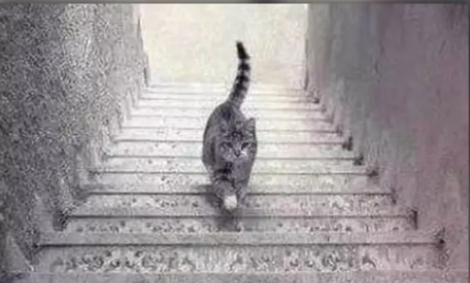

Slide 5
Sensation & Perception
An event occurs in the environment.
Each sense is associated with an organ. That organ’s nerves respond to the external stimulus: SENSATION.
Each sense organ has a mechanism for converting external stimuli into neural messages. This is called TRANSDUCTION.
Neural messages are interpreted by the brain as meaningful objects, events, faces, etc.: PERCEPTION.
EVENT → SENSATION → TRANSDUCTION → PERCEPTION

Slide 6
Sensation
Absolute threshold: the minimum stimulation needed to detect a particular stimulus 50% of the time.
The point at which something first becomes noticeable.
Varies with age.
Difference threshold: the minimum difference between two stimuli required for detection 50% of the time.
Just noticeable difference: the smallest difference that can be detected between one stimulus and another.
Depends on the situation.
Weber’s Law: difference in proportion is the key, not the absolute amount.

Slide 7
Sensation
Signal Detection Theory
Explores circumstances under which people respond differently to the same stimuli.
Seeks to predict how and when we detect the presence of a faint stimulus (signal) amid background stimulation (noise).
No single absolute threshold, detection depends partly on a person’s experience, expectations, motivation, fatigue, etc.
Video games can improve signal detection skills (e.g. presence of a stimulus, change in a stimulus).

Slide 8
Vision
Allows for the detection of movement, light, depth perception.
Light enters the eyes, which projects an image that our brain interprets.
Transduction: retina sends visual information to the optic nerve, which delivers the neural messages to the visual cortex.

Slide 9
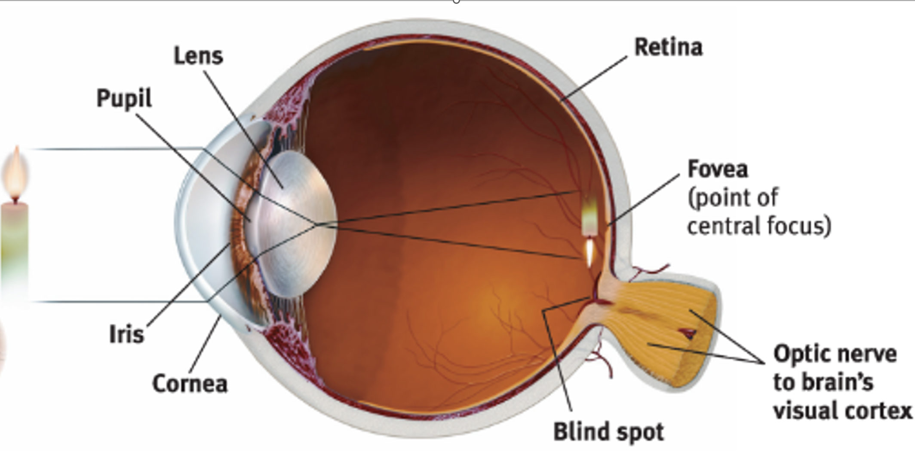
Vision
Light enters cornea, which is curved.
Passes through pupil.
Iris dilates or constricts in response to light intensity.
Lens focuses light into image on retina.
Retina receives upside-down image.
Brain reassembles into upright image.
Blind Spot Activity

Slide 10
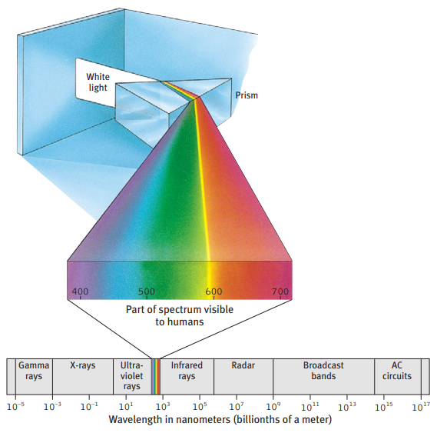
Electromagnetic Spectrum
Eyes don’t technically see color.
Pulses of electromagnetic energy strike the eye and perceived as color.
Humans see very small proportion of electromagnetic energy in the world.

Slide 11
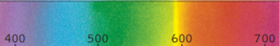
Trichromatic (Three-Color) Theory
Retina contains three different color receptors sensitive to red, green, and blue.
When stimulated in combination, can produce perception of many colors.
Short wavelengths: blue/ purple
Long wavelengths: red/orange
Medium wavelengths: green

Slide 12
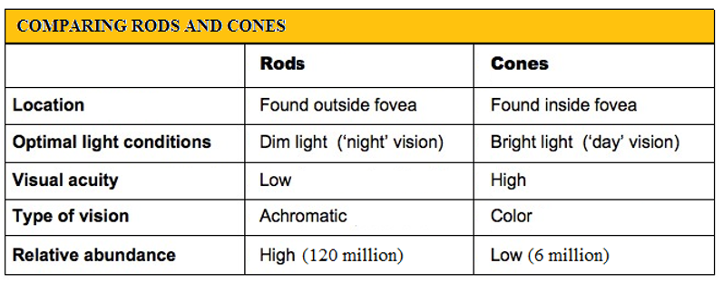
Retina
Rods: retinal receptors that detect black, white, and gray.
Necessary for peripheral vision and dim light, when cones don’t respond.
Cones: retinal receptors that function in daylight or well-lit conditions.
Detect fine detail and give rise to color sensations.
Less effective in dim light.

Slide 13
Color Detection Activity
Choose 2 different colored pencils.
Hold them behind your head.
Choose one at random and slowly bring it over your head and into your field of vision.
Make sure to keep your eyes focused straight ahead!
When you first begin to see the object, can you perceive it’s color?
Cones (color receptors) located in the fovea.

Slide 14

Opponent Process Theory
Cones process color through excitatory and inhibitory responses.
Overuse, fatigue, or overstimulation of one color component (red) causes the activation of its opponent (green).
Afterimage occurs because neurons processing red became fatigued, inhibition signal was reduced and green afterimage appeared.
Red-green, blue-yellow, white-black.

Slide 15
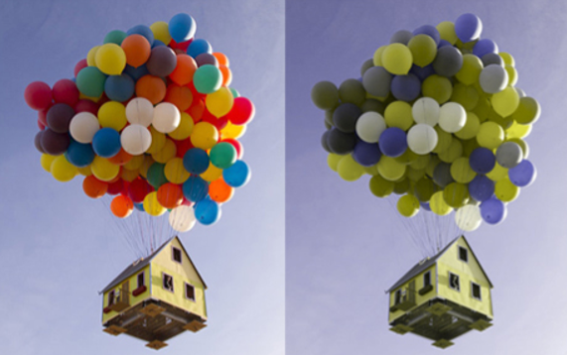
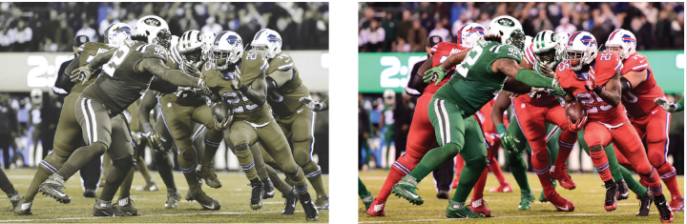
Color Blindness
Inability to distinguish colors.
X-chromosome linked recessive gene
10% of males
0.5% of females

Slide 16
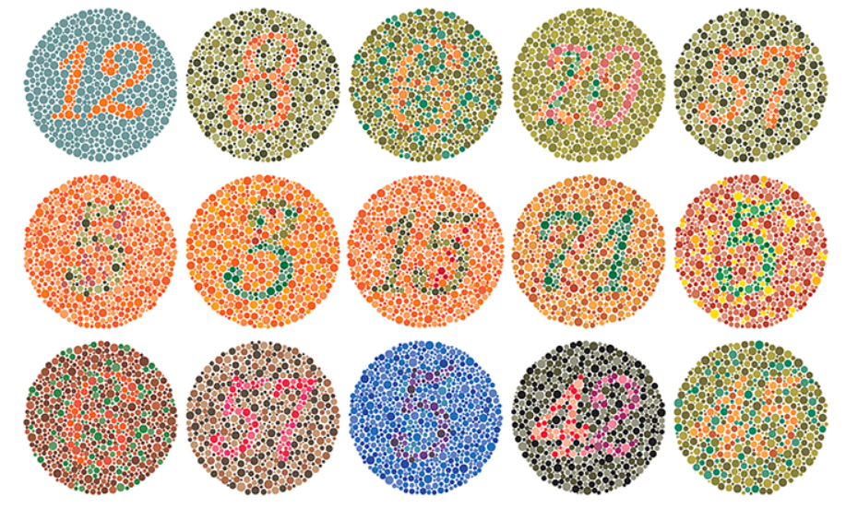

Slide 17
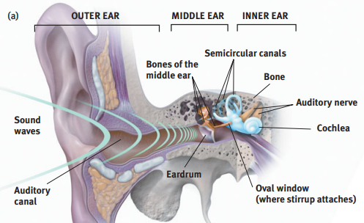
Hearing
Sound is a stimulus that travels in waves, which occur as vibrations in the air.
Outer ear funnels sound waves to ear drum.
Middle ear picks up vibrations and transmits them to cochlea.
Vibrations move fluid inside cochlea and causes hair cells on cochlea bend, which generate neural signals.
Signals sent to auditory cortex of temporal lobe.

Slide 18
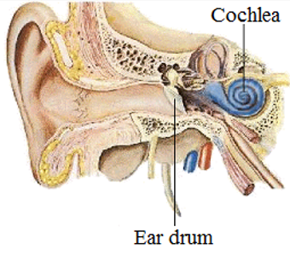
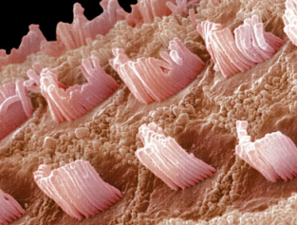
Hearing
Cochlea: small snail shaped structure in inner ear.
Sounds waves create move the cochlear fluid, bending the hair cells on the surface.
These tiny hairs are the sensory receptors that send neural signals to the brain for processing.

Slide 19
Hearing
Damage to hair cells in inner ear accounts for most hearing loss.
Disease, heredity, and exposure to loud noises are common causes of nerve deafness.
Ringing in ears after exposure to loud sounds is ear’s way of letting us know there was possible damage.
Prolonged exposure, short bursts of very loud noise, noises over 85 decibels can cause damage.

Slide 20


Slide 21
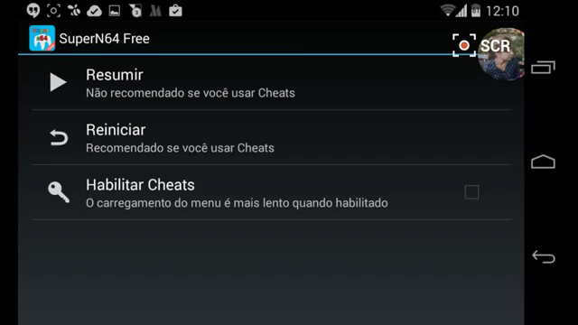
Auditory Illusions
Shepard tone
Binaural audio
Soundwaves hit each ear at different times and at different volumes to create the perception of distance.
Experienced through headphones.

Slide 22
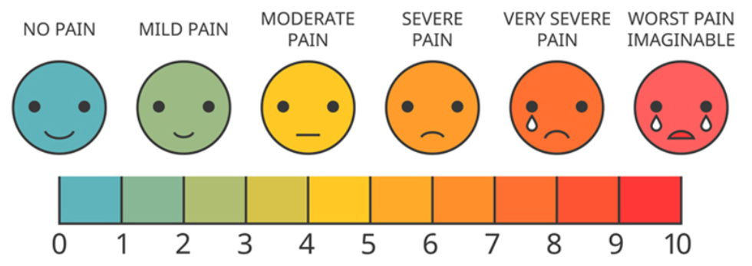
Touch
Transduction: sensory neurons in skin send impulse to central nervous system which stimulates motor neurons to react.
Subjective: people experience pain differently.
Emotional component: pain signals go partially to limbic system, where emotions are experienced.
Mind over matter (e.g. endorphins, placebos).
Soldiers Get Virtual Reality Therapy for Burn Pain - YouTube

Slide 23
Taste
Taste
Five basic tastes: sweet, sour, salty, bitter, umami.
Occurs in taste buds: taste receptors located in the folds on the surface of the tongue.
Transduction: physical stimulus activates taste receptor neurons which carry information to the brain.
Strongly influenced by our sense of smell (sensory interaction).
Spicy is not a taste.

Slide 24
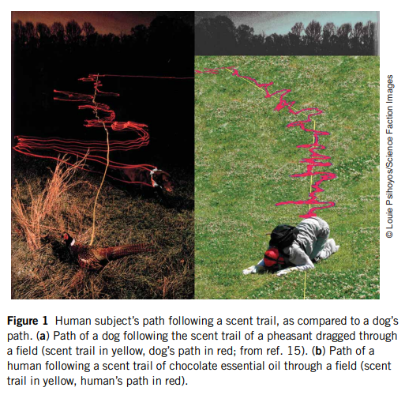
Smell
Smell
Physical stimulus (air molecules) enter nasal cavity through nose.
Receptors pass signals through olfactory bulb to the brain.
Millions of nerve cells in the nasal cavity vs. limited taste buds.

Slide 25
Perception
Top-down Processing
Conceptually driven processing.
Use already existing information to interpret environment.
Using your experience and expectations to interpret each item in context.
Bottom-up Processing
Data driven processing.
Take stimuli from the environment and attempt to determine its meaning.
Tiny elements combine to produce larger items.

Slide 26

Bottom-up Processing

Slide 27


Top-down Processing

Slide 28

Top-down Processing

Slide 29
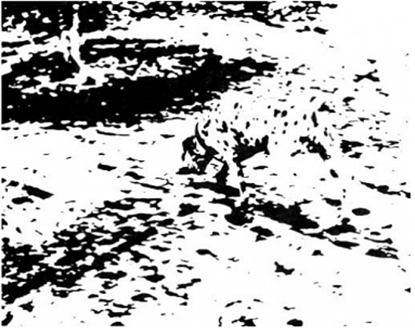
Perceptual Organization
Gestalt: an organized whole.
Tendency to integrate pieces of information into meaningful wholes.
“The whole is different from the sum of its parts.”

Slide 30
Activity
Look at the following pictures.

Slide 31


Slide 32


Slide 33


Slide 34


Slide 35


Slide 36
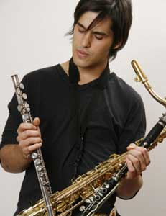

Slide 37


Slide 38


Slide 39

What do you see?

Slide 40
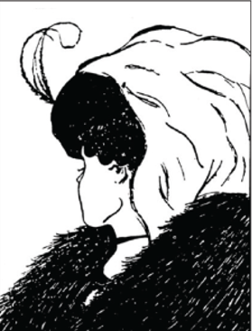
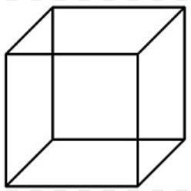
Perception
Perceptual set: a mental predisposition to perceive one thing and not another.
Will This Trick Your Ears? (Audio Illusions) – YouTube
https://www.youtube.com/watch?v=kzo45hWXRWU

Slide 41
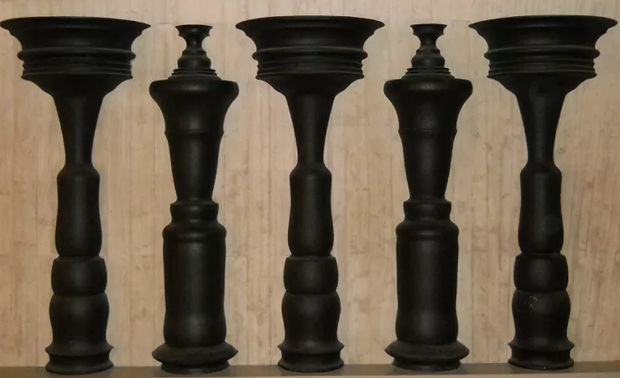
Perceptual Organization: Figure & Ground
Figure and Ground
Perceiving an object (the figure) as distinct from its surroundings (ground).

Slide 42







Slide 43
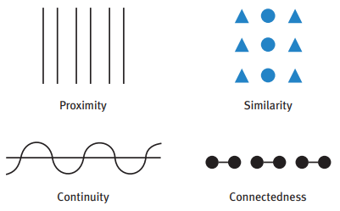
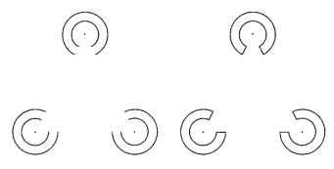
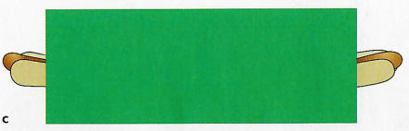
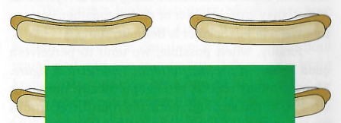
Perceptual Organization: Grouping
Proximity
Similarity
Continuity
Connectedness
Closure

Slide 44
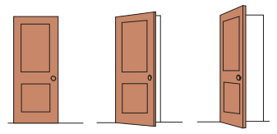
Perceptual Constancy
Perceptual constancy: perceiving objects as unchanging even as external conditions (angle, distance, illumination) change.
Shape constancy

Slide 45
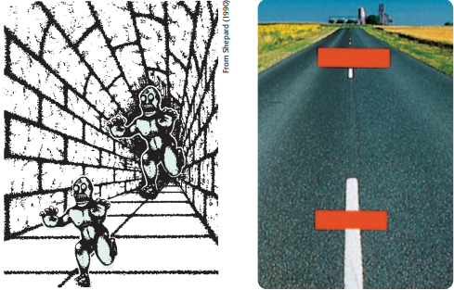

Size Constancy
Optical illusions:
Interplay of perceived size vs. perceived distance.
Once distance cues are removed, we can see they are the same size.

Slide 46
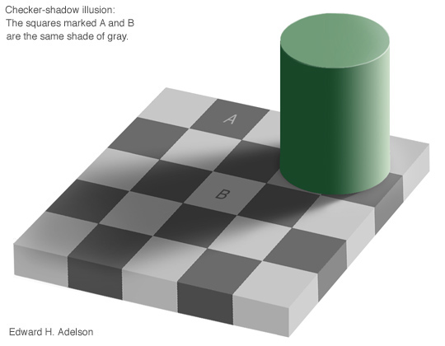


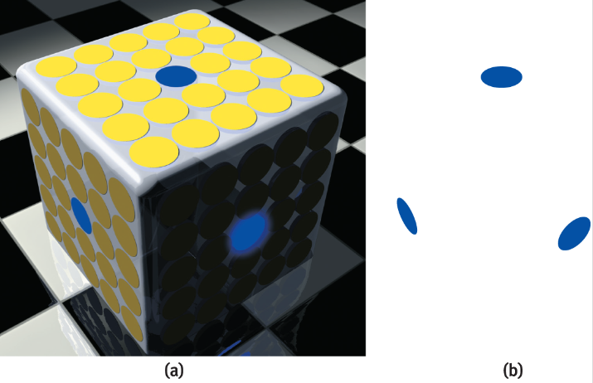
Color & Light Constancy
We evaluate colors in terms of context (shadow, light).

